Slide 1


Al-Maqraa
Supervised by:
Dr. Hanaa Bayoumi
Midyear Presentation

Slide 2
Our team
Ahmed Mohamed Sallam
Mohamed Gamal Abdelaziz
Farah Tawfik Salem
Omar Walid Ahmed
Mohamed Gaber Mohamed
20210614
20201146
20200378
20201126
20200436
Graduation Project
Academic Year 2023-2024

Slide 3
Agenda
Introduction
Related work
01
02
03
04
Motivation
Problem Significance
Background
07
08
05
06
Model Specifications
Software Specifications
Conclusion

Slide 4

01 Introduction

Slide 5
Introduction
Al-Maqraa, designed to aid Muslims in Quranic learning.
Focuses on improving pronunciation and memorization accuracy.
Recognizing the Quran's significance in Islam.
This platform supports the religious obligation of memorizing and accurately reciting the sacred text.
Al-Maqraa aims to bridge the gap by providing a technologically advanced solution that utilizes speech recognition and analysis to objectively evaluate Quranic recitations.

Slide 6
02 Motivation

Slide 7
Motivation
Commitment to making Quranic learning accessible to Muslims globally especially for non-Arabic speakers
Aid Muslims to overcome two significant obstacles : pronunciation and memorization.
Scheduling conflicts and distance limitations could hinder the one from learning
Al-Maqraa seeks to close this gap by enabling users to practice and get feedback at any time

Slide 8
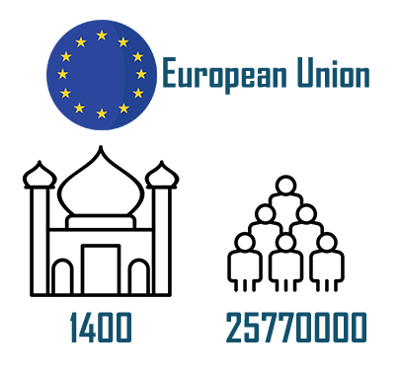
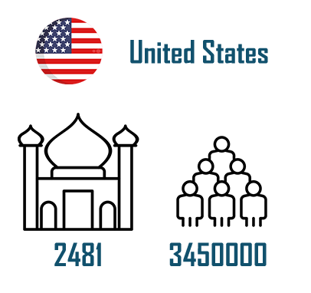
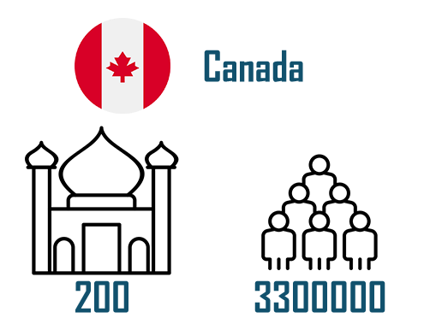
Non- Muslims Country

Slide 9
03 Problem significance

Slide 10
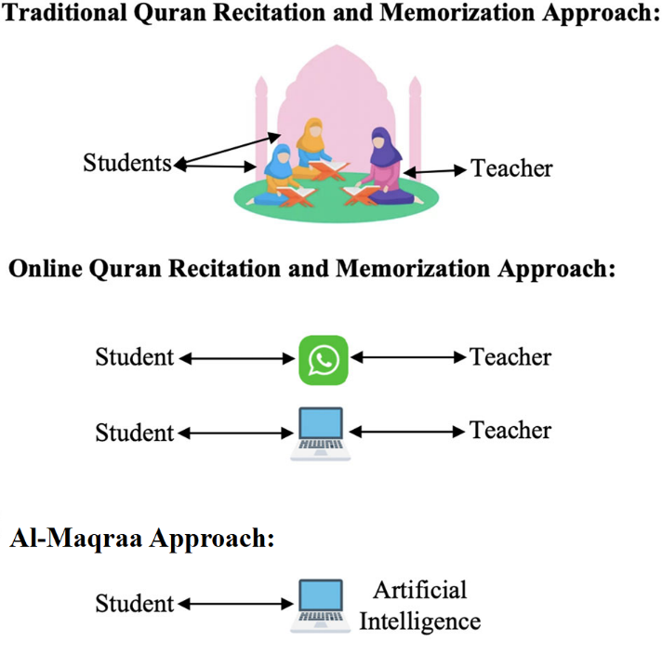
The lack of mosques in western countries is a major obstacle for Muslims to look for guidance and teaching for the Quran.
Fixed timing for sheikh instructions makes it difficult for people to study Quran at their convenience.
The absence of immediate feedback on individual recitation impedes the learning process.
the majority of systems available checks if the text has been committed to memory; they do not check if the pronunciation is correct.

Slide 11

"روى الترمذي وأبو داود واللفظ له ، عن عبد الله بن عمرو رضي الله عنهما قال : قال رسول الله صلى الله عليه وسلم : ( يُقَالُ لِصَاحِبِ الْقُرْآنِ : اقْرَأْ وَارْتَقِ وَرَتِّلْ ، كَمَا كُنْتَ تُرَتِّلُ فِي الدُّنْيَا ، فَإِنَّ مَنْزِلك عِنْدَ آخِرِ آيَةٍ تَقْرَؤُهَا ) "

Slide 12
04 Background

Slide 13
Flutter :
Open-source UI software development toolkit created by Google, enabling the creation of natively compiled applications for mobile, web, and desktop from a single codebase. It uses the Dart programming language and provides a rich set of pre-designed widgets for building visually appealing and responsive user interfaces.
Dot NET :
Is a free, open-source, cross-platform framework developed by Microsoft for building a variety of applications. It supports multiple programming languages and includes libraries and runtime for developing applications for web, desktop, mobile, gaming, IoT, and cloud platforms.

Slide 14
Preprocessing :
refers to the preparation and manipulation of raw data before it is fed into a machine learning algorithm. This step involves tasks such as cleaning, normalization, handling missing values, and feature engineering, ensuring that the data is in a suitable form for effective model training and analysis.
Voice Signal :
an analog representation of sound waves, converted into an electrical signal, commonly used in telecommunications and audio processing. It captures the vocal nuances and frequencies, enabling communication and various applications in technology.

Slide 15
Machine Learning (ML) model :
A computational algorithm that learns patterns from data, making predictions or decisions without explicit programming. It is trained on labelled examples to generalize and perform tasks, ranging from image recognition to natural language processing.
HMM : Hidden Markov Model
VQ : Vector Quantization
ANN : Artificial Neural Network
MLLR : maximum likelihood linear regression

Slide 16
05 Related Work

Slide 17
Commercial Application

Slide 18



 | Tarteel | Tamkeen | Tasmee
Android & IOS
Free
Support diacritics?
Connect the verse with the next?
Type of error the app focuses on
Streaks & Session history
Obvious errors
Hidden errors

Slide 19
Existing Literature Reviews

Slide 20
Subject | Recitation recognition | Recitation veriﬁcation | Traditional speech recognition methods | End-to-end speech recognition methods | Audio feature extraction techniques | Datasets | Mobile applications | Traditional Models | End-to-end Models
Veriﬁcation system for Quran recitation recordings (Sherif Mahdi Abdo & Ayat Hafzalla ,2017) | ✓ | ✗ | ✓ | ✗ | ✓ | ✗ | ✗ | ANN HMM VQ
Deep Diacritics-Based Recognition Model for Arabic Speech (Sarah S. Alrumiah,2023) | ✓ | ✓ | ✗ | ✓ | ✓ | ✓ | ✗ |  | TDNN-CTC RNN – CTC Transformer
Intelligent Quran Recitation Recognition and Veriﬁcation: Research Trends and Open Issues (Sarah S. Alrumiah, 2023) | ✓ | ✓ | ✓ | ✓ | ✓ | ✓ | ✓ | HMM GMM VQ K-Means SVM TDNN | LSTM MaLSTM HMM+BLSTM

Slide 21
05 Model Specifications

Slide 22
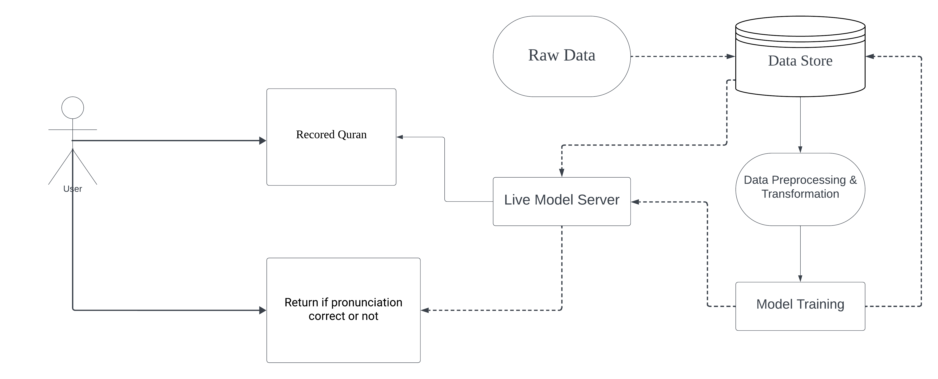
Machine Learning Architecture

Slide 23
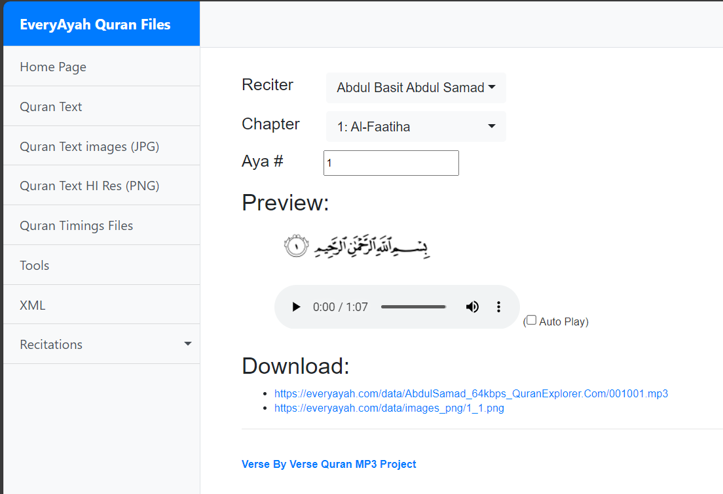
Machine Learning Architecture
1. Raw Data (Data Set)
EveryAyah Dataset
- Whole Quran
- Have 7 Male Expert
- Each imam is separated from the other
- Have 6236 Wav file

Slide 24
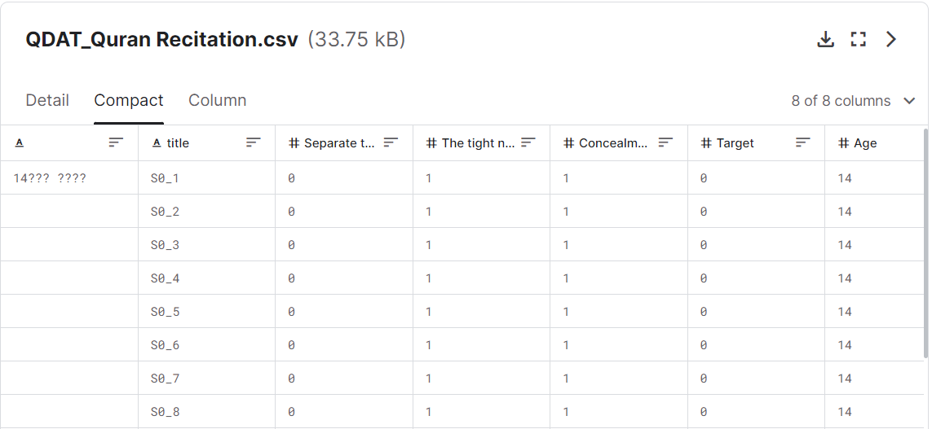
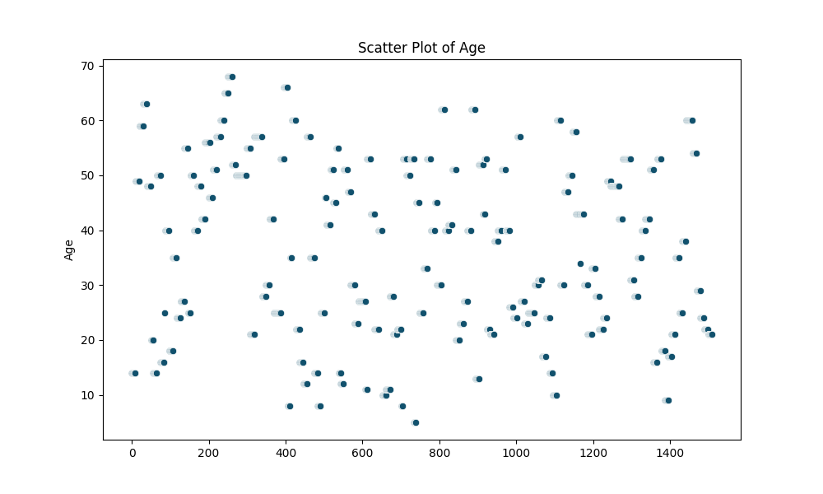
Machine Learning Architecture
1. Raw Data (Data Set)
QDAT_Quran Recitation DataSet
- قَالُوا لَا عِلْمَ لَنَا ۖ إِنَّكَ أَنتَ عَلَّامُ الْغُيُوبِ
1159 Female,-
350 Male

Slide 25
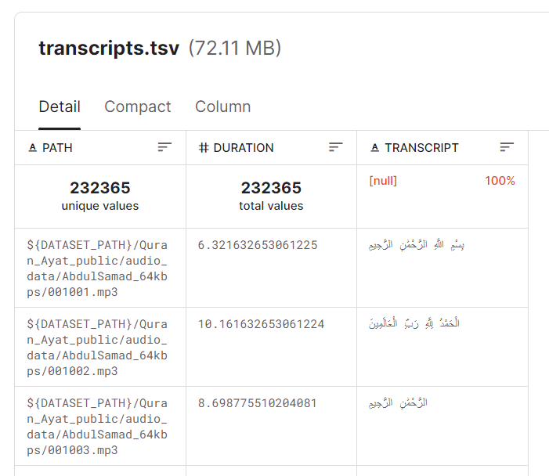
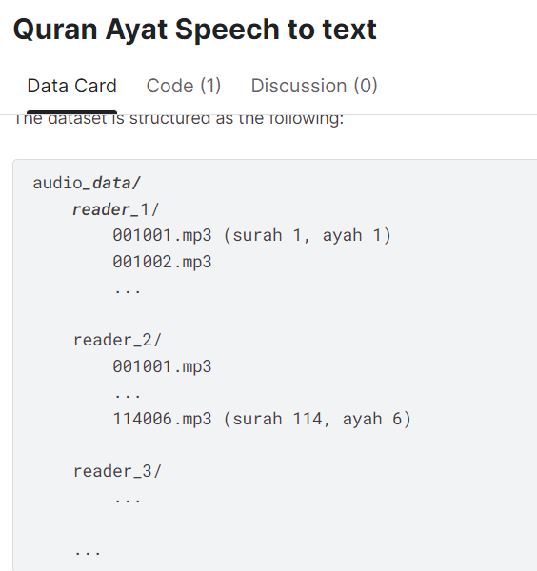
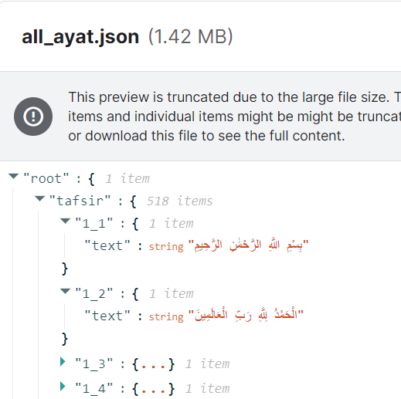
Machine Learning Architecture
1. Raw Data (Data Set)
Quran Ayat Speech to text Dataset
- Whole Quran
- 38 expert male reciters
- 232365 Wav File,43GB

Slide 26
Machine Learning Architecture
2. Data preprocessing & Transformation
Data Cleaning:
Identifyand remove any corrupted audio files or those with poor recording quality. Ensure all files are in a consistent format (e.g., WAV) and have a common sample rate.
Resampling:
Resample all audio files to a common sample rate (e.g., 16 kHz) to ensure consistency across the dataset.
Normalization:
Normalize the amplitude of the audio files to a standard range, such as between -1 and 1, to prevent issues during model training.

Slide 27
Machine Learning Architecture
2. Data preprocessing & Transformation
Time and Frequency Domain Analysis :
Analysing the audio in both the time and frequency domains provides valuable insights and enables various processing techniques.
Feature Extraction:
Extract relevant features, such as MFCCs, spectrogram features, and chroma features, from the audio data using a library like Librosa.
Choose the type of filter and its parameters based on the characteristics of your audio data and the requirements of your machine learning task.

Slide 28
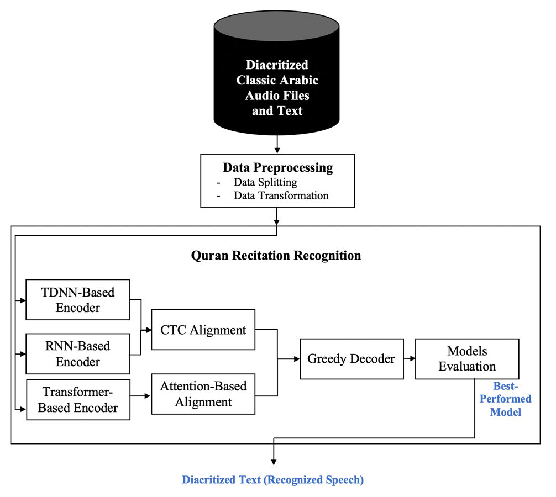
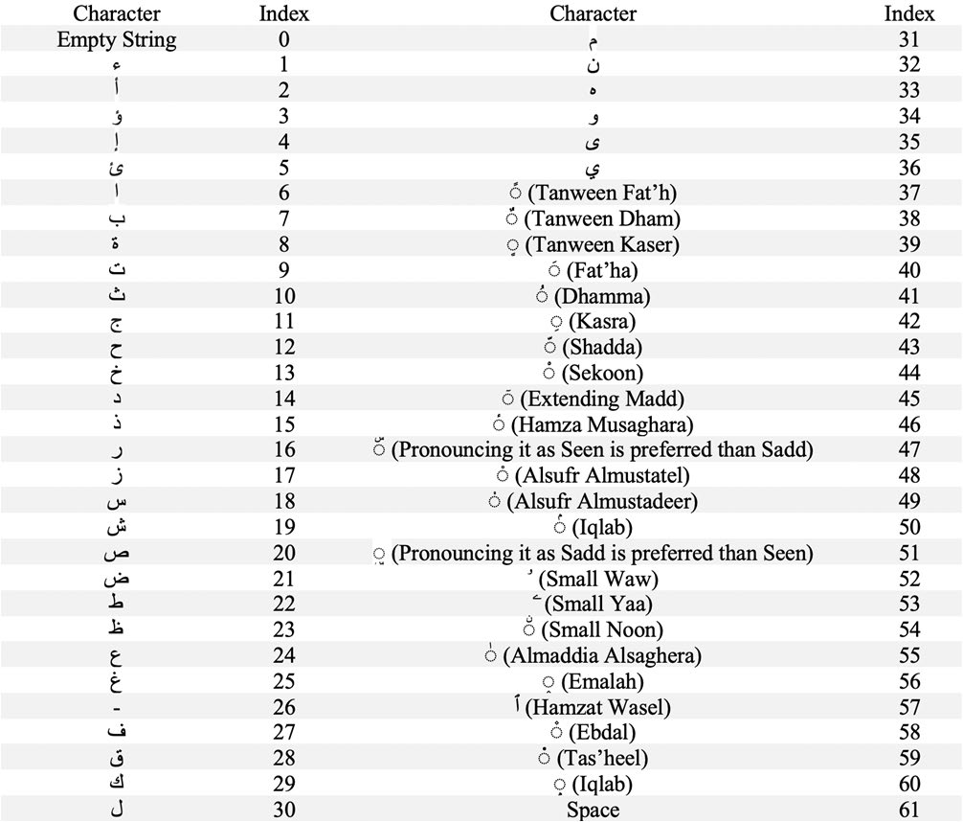
Machine Learning Architecture
Training Model

Slide 29
06 Software Specifications

Slide 30
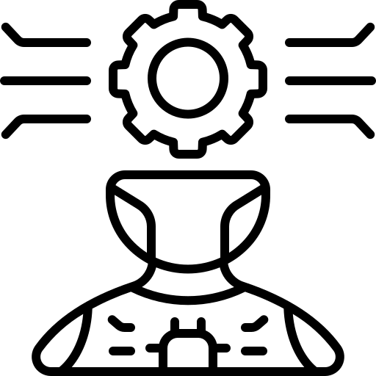

Developers
Experts
Stakeholders
Users
AI engineer
Testers

Slide 31
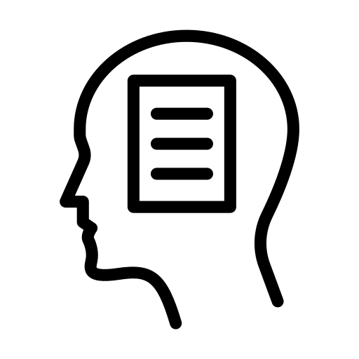


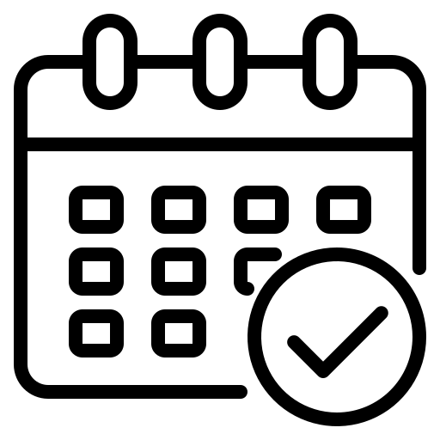
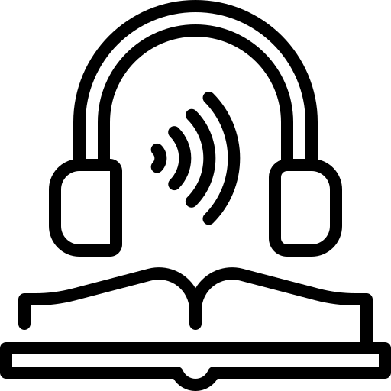

Functional Requirements
Authentication
Quran Memorization
Quran Recitation
Daily Tracker
Listening for Imam
Bookmarking
User could login and sign up
User can repeat and practice memorized verses.
Recite a specific (Surahs) and (Ayahs)
Visual representations of daily progress
Listen to recorded Quranic recitations by Imams.
Bookmark specific (Surahs) or (Ayahs)

Slide 32

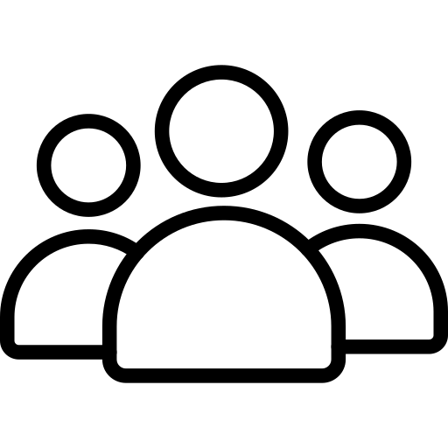

Non-Functional Requirements
Security
Performance
Scalability
Maintainability
Protect user’s data
Acceptable Response time
Handle growing number of users
Implement a maintainable code

Slide 33


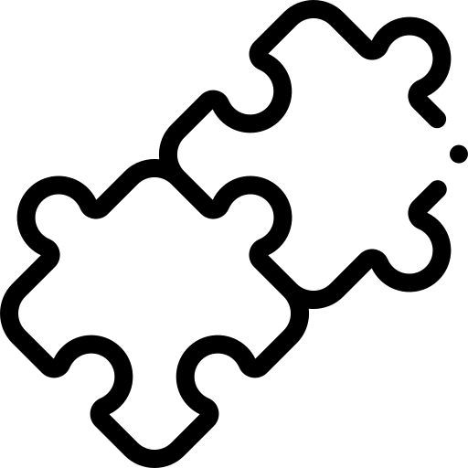
Non-Functional Requirements
Availability
Usability
Availability 24/7
User interface easy to navigate
Compatibility
Compatible with different versions of mobile devices and screen sizes.

Slide 34
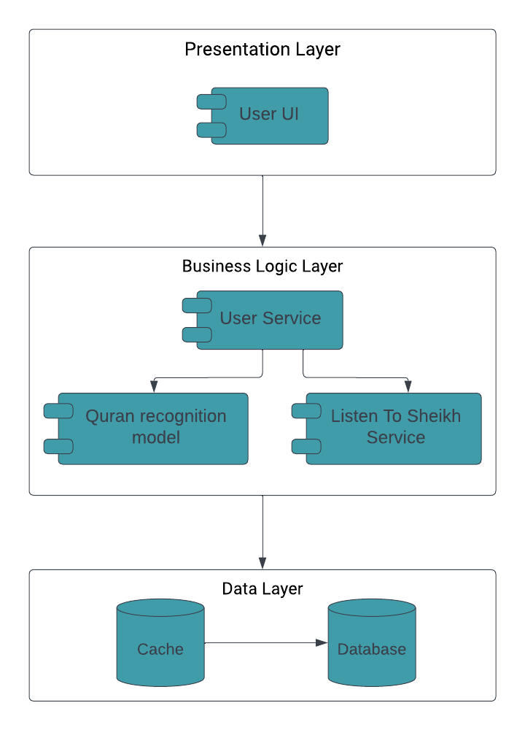
System Architecture
Layered architecture
Why?
Add level of abstraction.
Ease of development.
Reduced dependency.
Testing is easier.

Slide 35
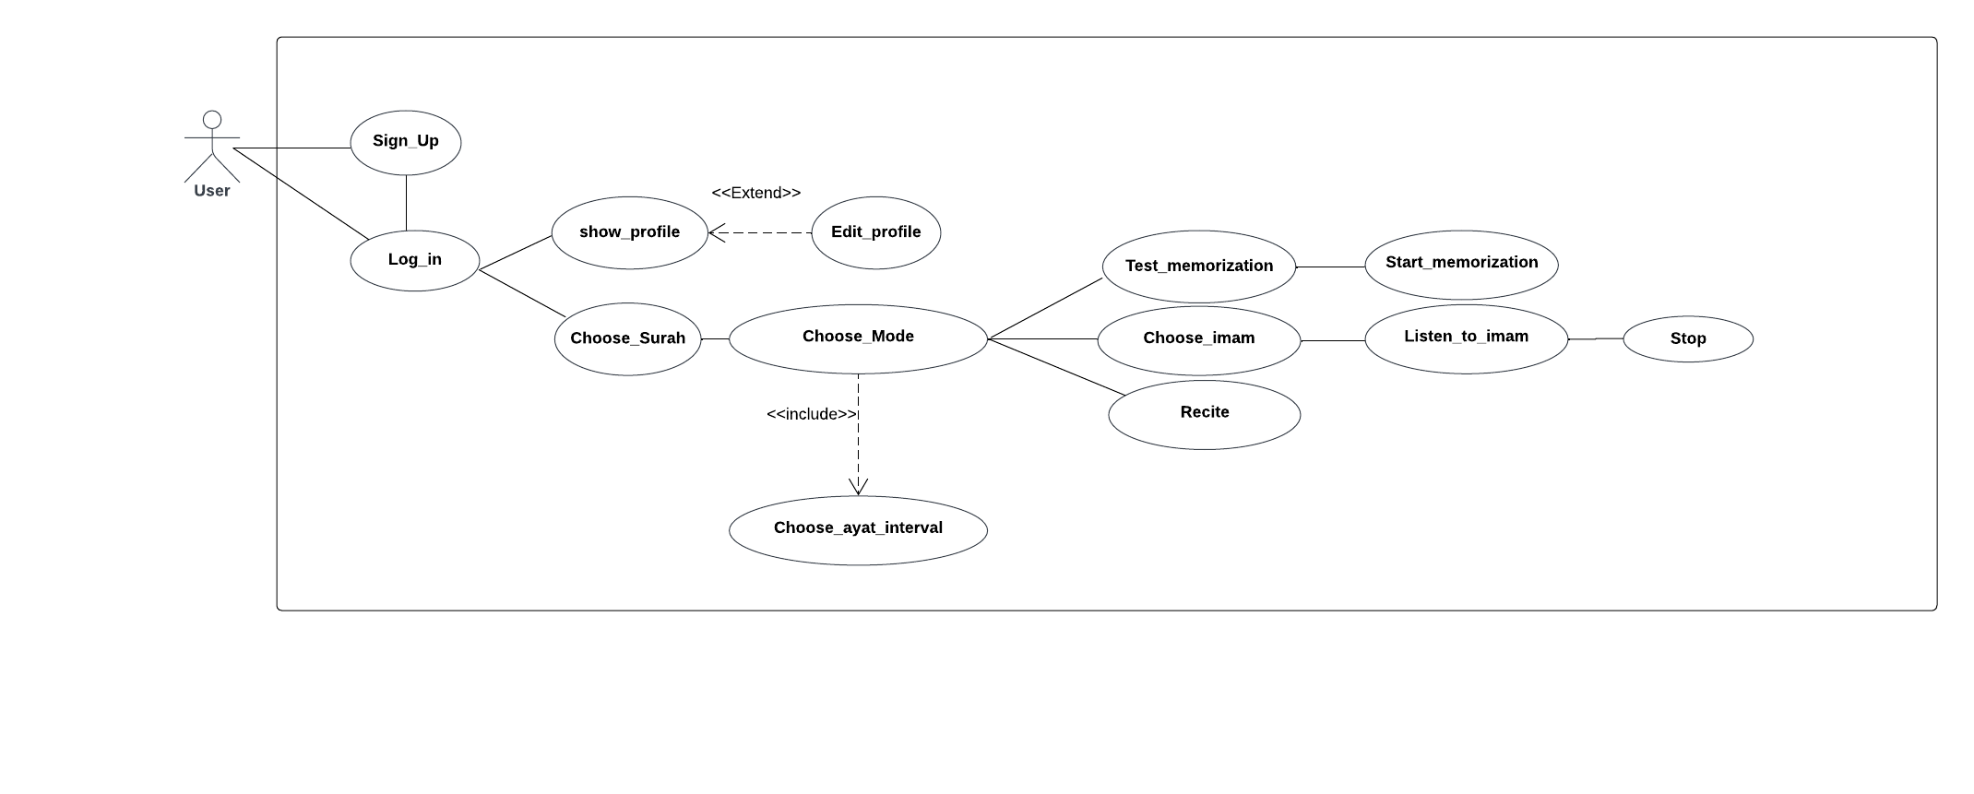
Use Case

Slide 36
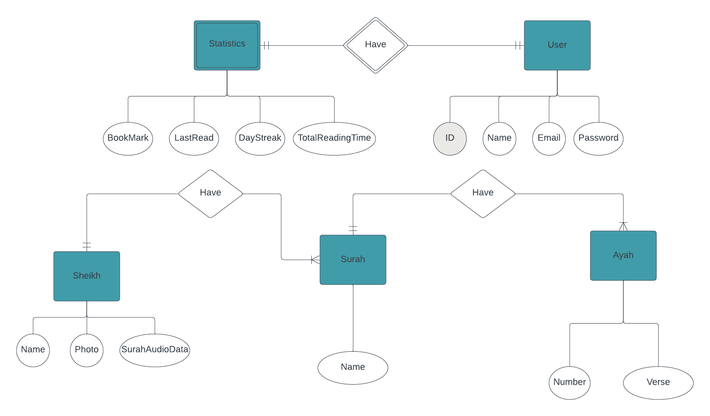
ERD

Slide 37
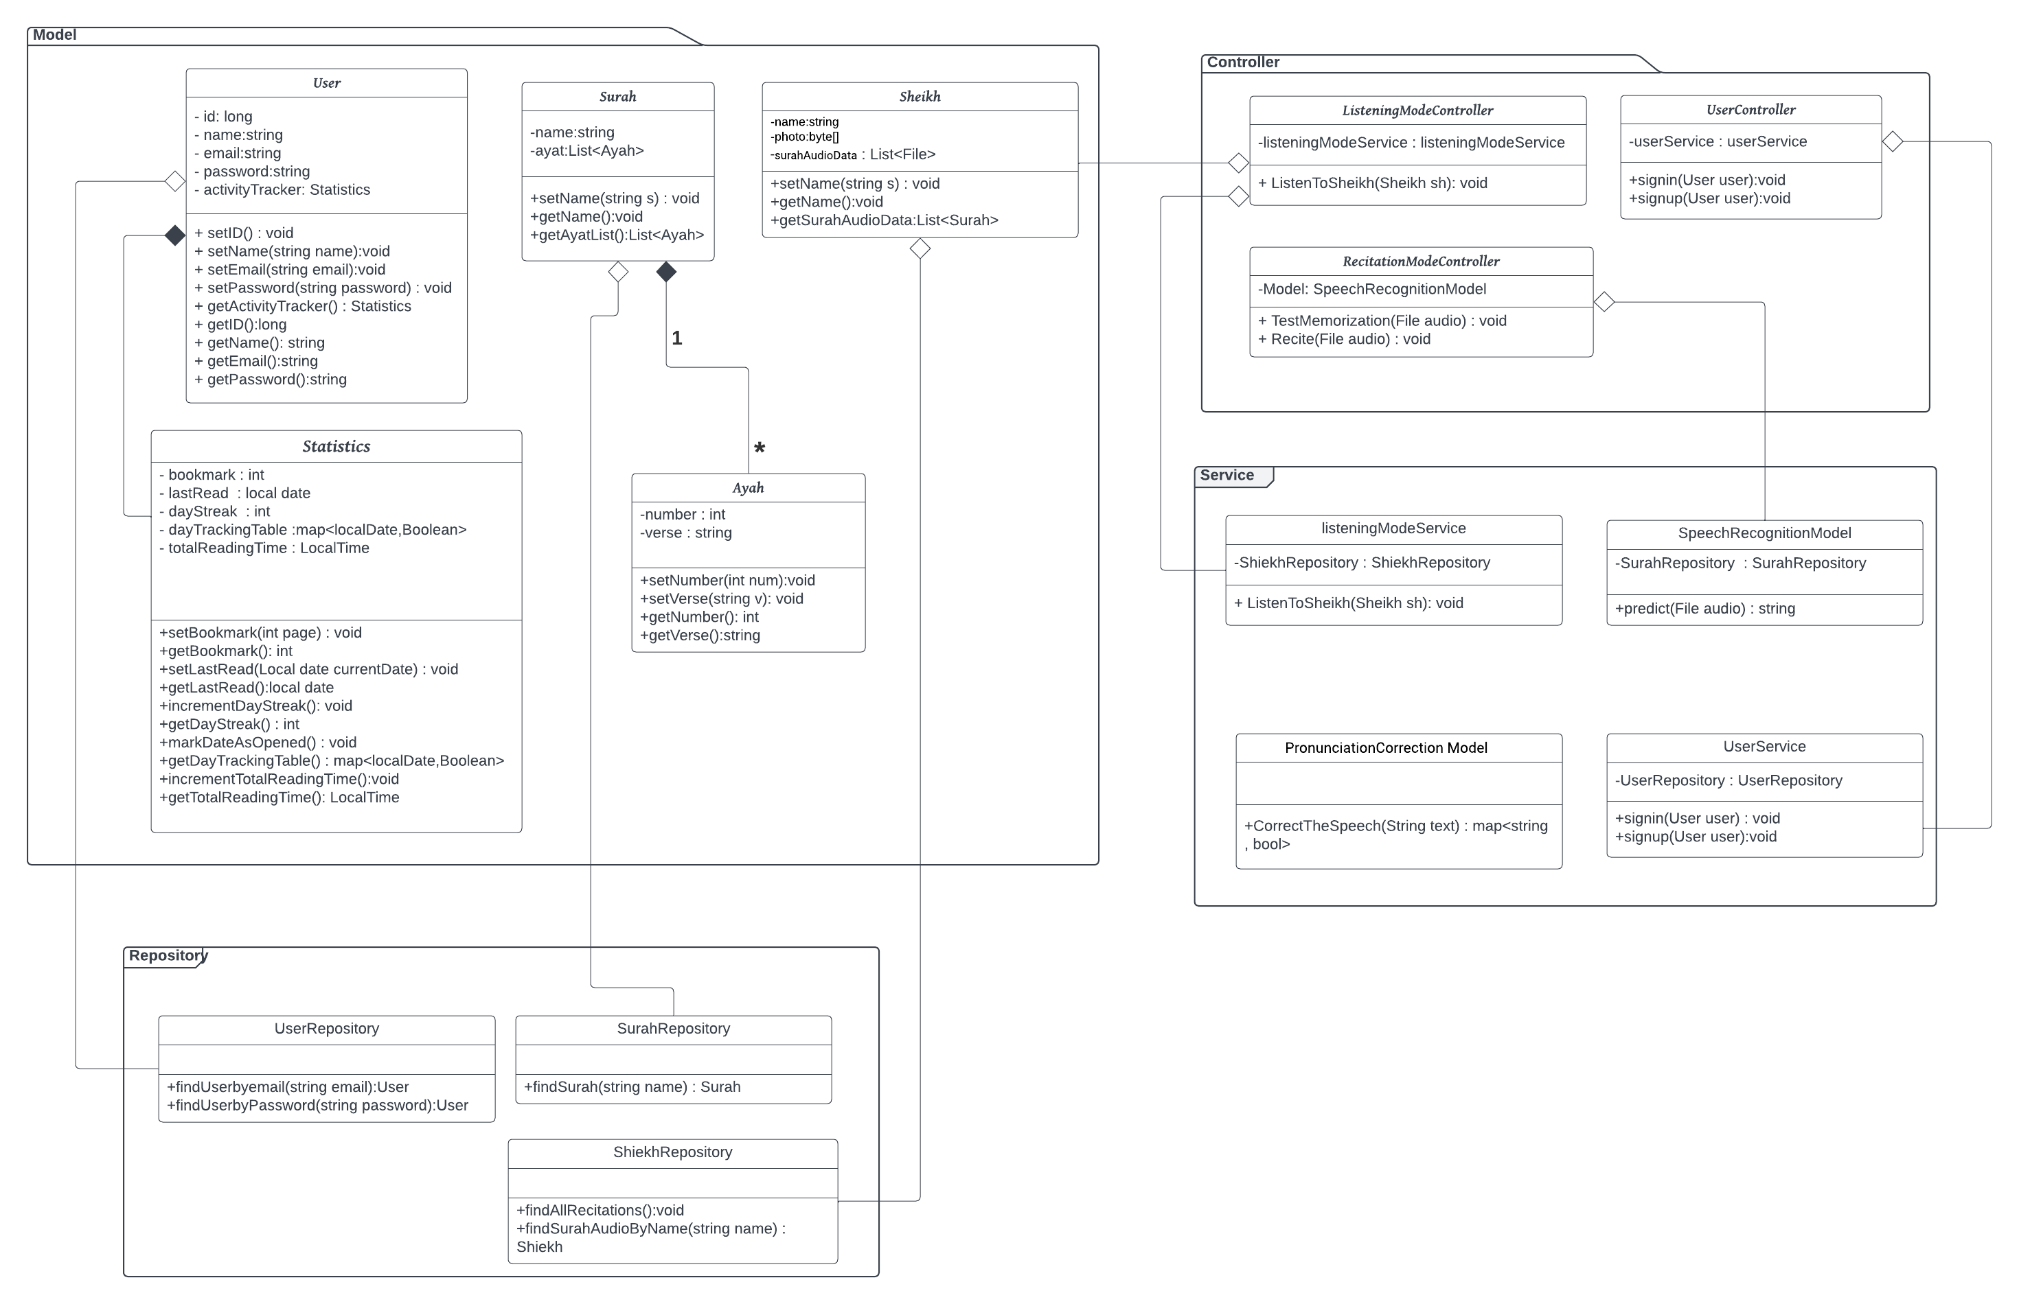
Class Diagram

Slide 38
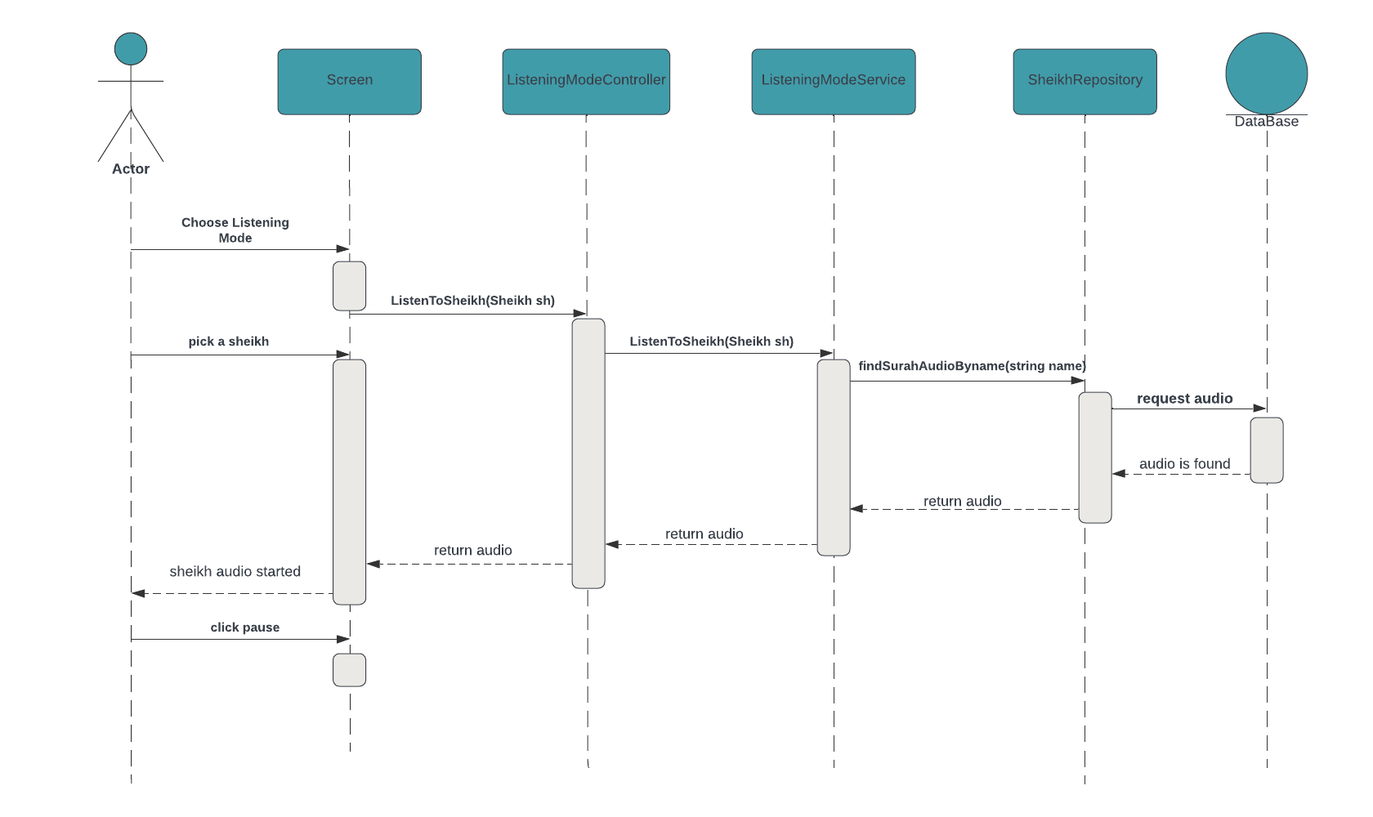
SD Listening to sheikh

Slide 39
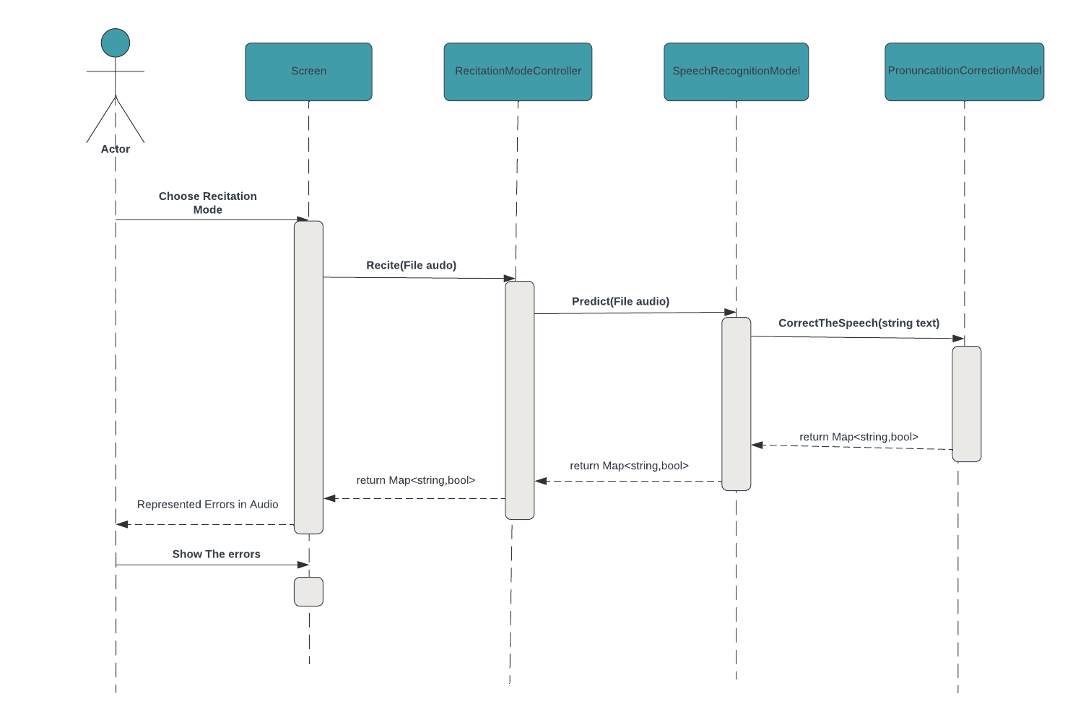
SD Recitation Mode

Slide 40
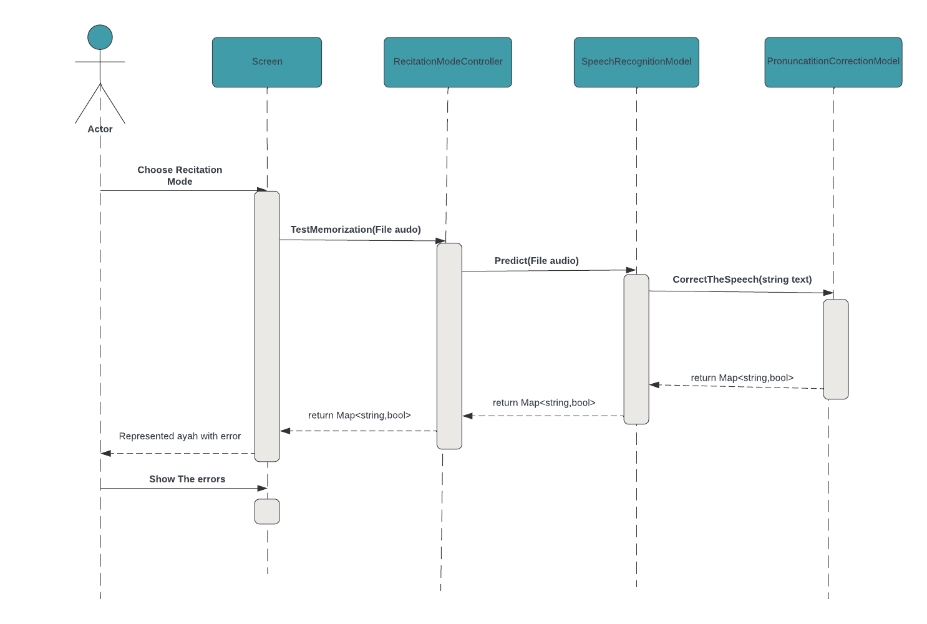
SD Test Memorization Mode

Slide 41
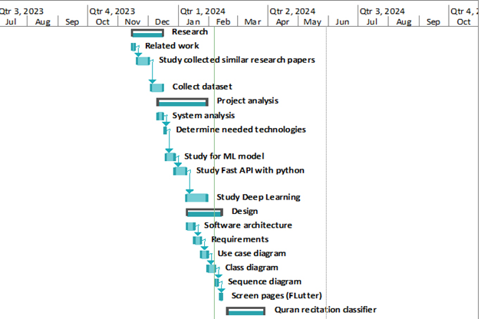
Time Plan

Slide 42
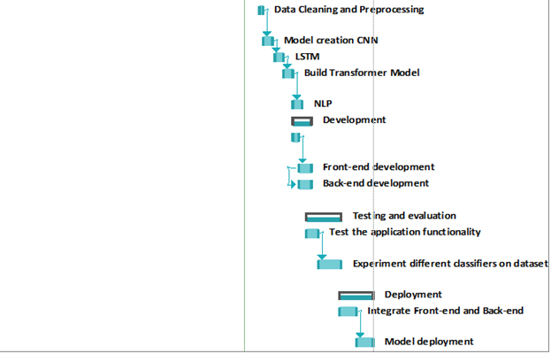
Time Plan

Slide 43

Mobile Demo

Slide 44
07
Conclusion

Slide 45
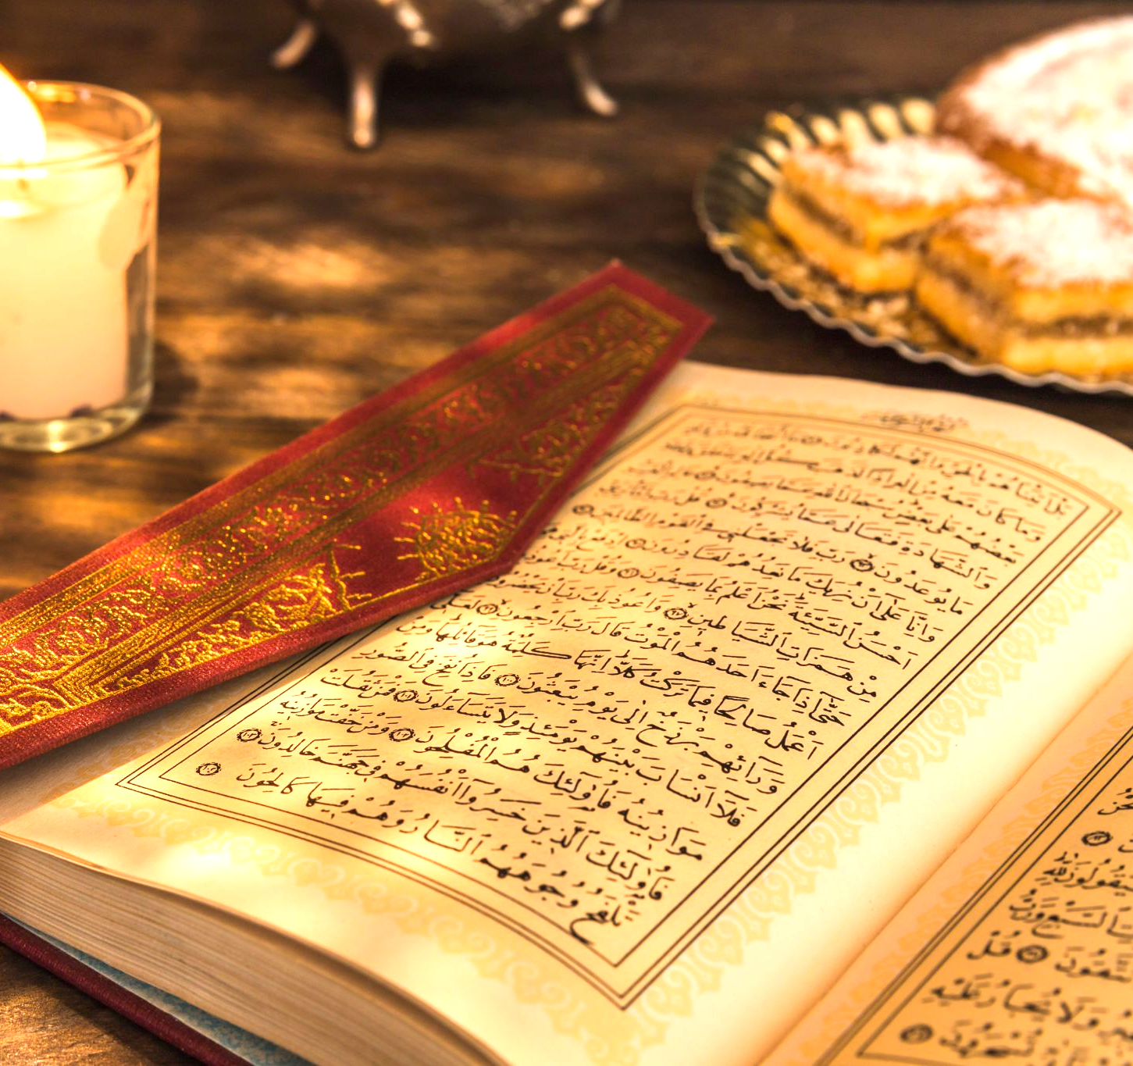
Conclusion
Al-Maqraa serves as a modern, accessible, and personalized solution for Quranic learning. Empowering individuals to engage with the Quran at their convenience.
"الماهر بالقرآن مع السفرة الكرام البررة، والذي يقرأ القرآن ويتعتع فيه وهو عليه شاق له أجران"

Slide 46
Thank You

